Slide 1
Voting Matters
Thursday, August 6, 2020
Gail L. Pellerin, County Clerk 831-454-2419 * info@votescount.us

Slide 2
Yes, the election will be held November 3
Congress passed the law setting the date of the nationwide presidential election to be the Tuesday after the first Monday in November back in 1845 and it hasn’t changed yet.
The President can’t unilaterally decide to cancel or postpone the November 3 election by an executive order due to a national emergency or even if he declared martial law. Martial law does not suspend the constitution.
After all, we are not voting for President. We are voting for electors who will represent our state at the Electoral College.
Federal law states that if the Electoral College doesn't vote on the set date, the president and vice president's terms will automatically expire at noon on January 20, 2021.
Then, control of the presidency would go down the line of succession first to the Speaker of the House of Representatives (if House elections occurred) and then to the president pro tempore of the US Senate.

Slide 3
Ballots will be mailed to ALL voters in October for the November 3 election!
We will mail ballots to all voters in Santa Cruz County to promote safe voting at home.
We will have 15 drop boxes available 24/7 until 8pm Election Night, plus drop boxes at each voting location, city clerks’ office & postage paid envelopes for easy return.
We plan to have 17 in-person voting locations open Saturday – Tuesday, Oct. 31 to Nov. 3 to flatten the voting curve, per the Governor’s Executive Order to have 1/10k voters.

Slide 4
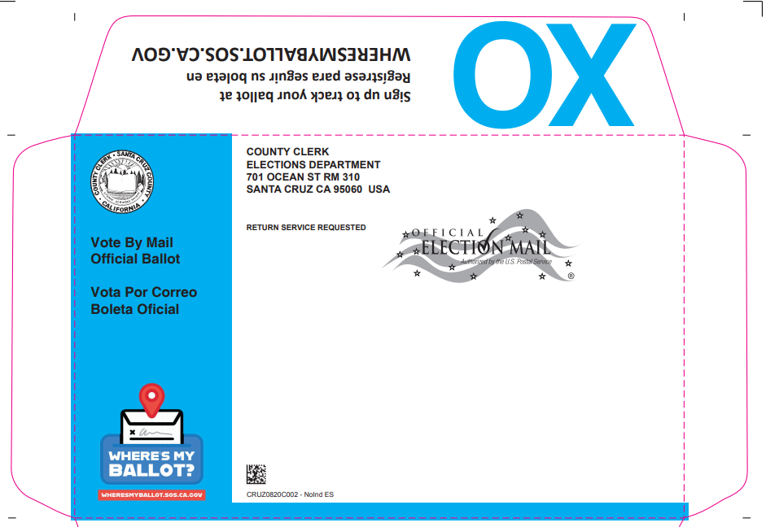
Our ballots will be mailed with a hug & a kiss!
Voters can sign up for BallotTrax to track their ballot!
Voters need to be sure to sign their name in their own handwriting.
There will be opportunity to cure a signature that does not compare or provide a missing signature.

Slide 5
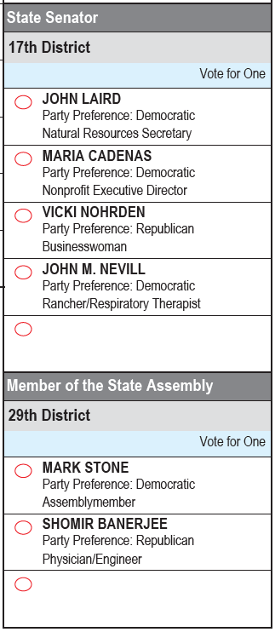
Our voting system – paper ballots you mark
Fill in the bubble to the left of your choices.
Some contests are vote for one. Some are vote for no more than two or three.

Slide 6
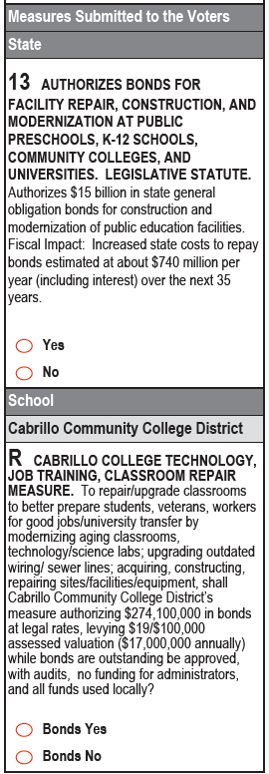
State Propositions and local measures
Fill in the bubble to the left of your choices.
If it is a local bond, the law requires the choices to be Bonds Yes and Bonds No, instead of just Yes and No.
State Propositions have numbers.
Local Measures have letters.

Slide 7
How to fill out your ballot envelope.
If you have someone return your ballot for you, they need to provide their name, signature and relationship to you here.
Sign your name here. Don’t let someone else sign for you!
Print your name.
Address.
Way to contact you!

Slide 8
Safeguards of voting the ballot mailed to you
Postmark + 17 (new law)
Ballots that are postmarked on or before Election Day or are time stamped or date stamped by a bona fide private mail delivery company on or before Election Day and received by the county elections official by the 17th day after the election shall be considered received on time.
The signature on the ballot envelope is compared to the signature on file. Cure for unsigned ballot envelopes or non-comparing signatures
Voters who failed to sign their vote-by-mail ballot envelope or has a signature that does not compare to what is on file will have until 2 days prior to the certification of the election to provide a signature on a Signature Statement to the County Elections Department. The Signature Statement may be returned to the county elections official by mail, FAX, email, hand-delivered, or dropped off at a voting location or drop box.
No one can solicit the vote of a vote-by-mail voter, or do any electioneering, while in the residence or in the immediate presence of the voter, and during the time he or she knows the vote-by-mail voter is voting.
Any person who knowingly violates this section is guilty of a misdemeanor.

Slide 9
What about fraud?
In a Washington Post analysis of data collected by three vote-by-mail states with help from the nonprofit Electronic Registration Information Center (ERIC) found that officials identified just 372 possible cases of double voting or voting on behalf of deceased people out of about 14.6 million votes cast by mail in the 2016 and 2018 general elections, or 0.0025%.
The Heritage Foundation maintains a database of all recent instances of recorded voter fraud and found just 204 reported cases involving the fraudulent use of vote-by-mail ballots over the past 20 years — only 143 resulted in convictions. That means that over the last two decades, about 0.00006% of total vote-by-mail votes cast were fraudulent.
In Santa Cruz County, since 1993 there has been 1 case of voter fraud where a property owner voted and returned a ballot for a tenant. We caught the incident during our standard signature checking procedures.
Most cases are people guilty of “over-helping.” Spouses signing for the other. Parents signing for their children.

Slide 10
Easiest types of fraud
Make false statements.
Pit groups against each other to cause division.
Get people to question the integrity of their elections systems.
Prevent people from exercising their right to vote.
Ultimate Goal: keep people from voting.

Slide 11
voting by mail in the US
29 states plus DC already have some form of “no-excuse” laws which allows voters to request and receive ballots by mail.
Colorado, Hawaii, Oregon, Utah, and Washington hold all elections by mail.
Three quarters of votes are by mail in Arizona, California, and Montana.
California will have all mail in November.
New Hampshire and Michigan have eased their vote-by-mail requirements.
16 states require a reason to get a ballot in the mail, and 8 of those states say that fear of getting COVID-19 is not a valid reason.

Slide 12
They said it so well
“On one hand, we shouldn’t be complacent about fraud or the integrity of our elections. But on the other hand, we shouldn’t let unfounded fears prevent us from administering a fairer and more representative election. Election officials should do everything they can to detect and mitigate potential fraud while also educating the public about these efforts and about the typically low levels of fraud in our elections.” - University of Chicago political scientist Anthony Fowler
In a 65-Tweet thread about allegations of vote-by-mail fraud, Ellen Weintraub, US Federal Election Commissioner wrote: “Such falsehoods are not mere words. These falsehoods may well undermine the American people's faith in our democracy. And the *real* fraud would be if U.S. citizens were deterred from voting and our government reflected the consent of fewer of the governed.”

Slide 13
How to return your ballot after voting from home
Voters may return their ballot in one of the following ways:
Drop it off at one of our 24-hour drop boxes
Aptos - Cabrillo College Parking lot R by the stadium
Aptos – Public Library, 7695 Soquel Dr.
Aptos - Polo Grounds near the dog park, 2255 Huntington Dr.
Ben Lomond - Highlands Park, 8500 Highway 9
Capitola – 420 Capitola Ave in the City Hall parking lot
Felton - Covered Bridge Park at Mt. Hermon and Graham Hill Rd
Santa Cruz - 701 Ocean St in front of the County Government Center
Santa Cruz – 212 Church St in the public parking lot
Scotts Valley – 1 Civic Center Dr in the City Hall parking lot
Watsonville – 316 Rodriguez St in the municipal public parking lot 14
Watsonville – 1432 Freedom Blvd parking lot
UCSC Quarry Plaza
We will add three more drive-up drop off boxes for November.
Return it in person before and including Election Day at the County Elections Office or any of the City Clerks’ Offices.
Return it to a voting location open Saturday, Oct. 31 to Tuesday, Nov. 3.
Mail it so it is received on time – ballots postmarked on or before Election Day and received by November 20, 17 days after the election, will be considered received on time.
Any California voter can return their ballot to any drop box or voting location in the state of California.

Slide 14
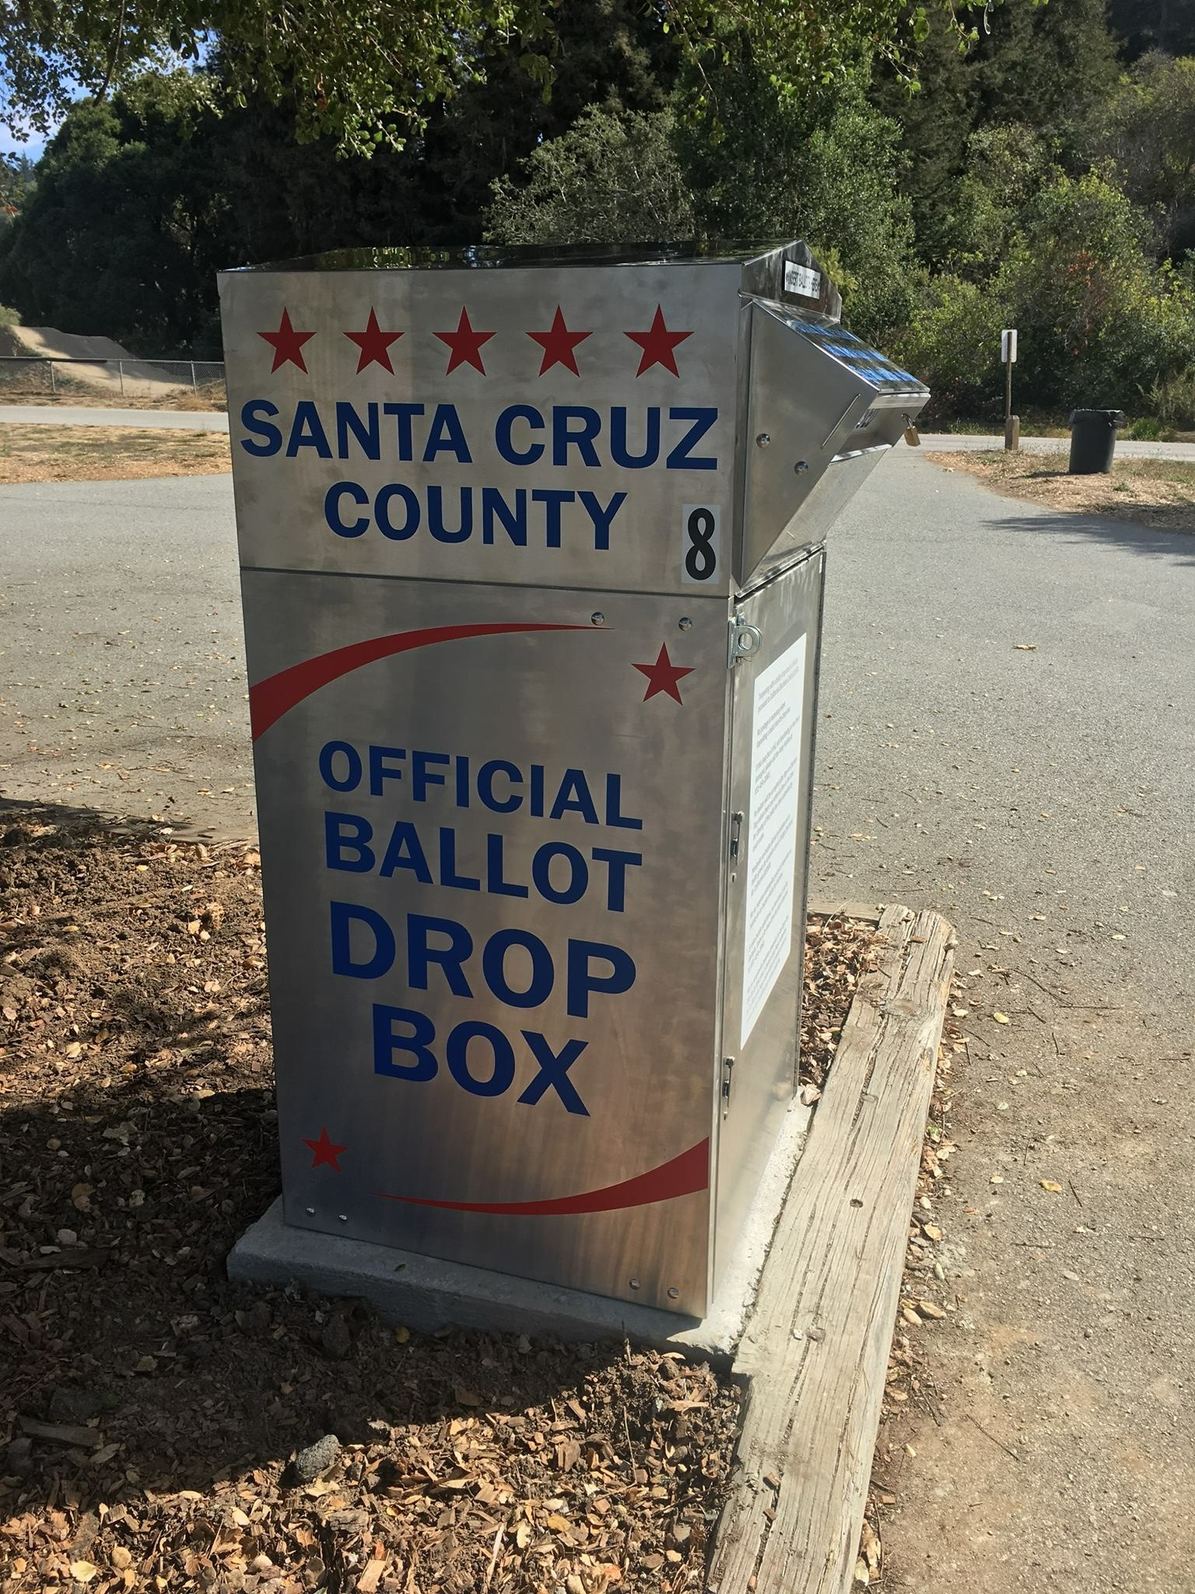
Most ballot drop boxes are accessible 24/7 and you don’t have to leave your car!

Slide 15
Be an informed voter. It’s 3 easy steps.
Sign up to vote or update your info at RegisterToVote.ca.gov
Check up
Check your info at VoterStatus.sos.ca.gov
Track it
Sign up to track your ballot at WheresMyBallot.sos.ca.gov
Sign up

Slide 16
Voter Registration
Deadline is October 19.
Voters can register to vote online at www.registertovote.ca.gov.
Cards are available at post offices, city halls, DMV, or we can mail them to a voter.
Voter outreach is limited due to COVID-19.
If a voter does not sign up in time, California has Same Day Voter Registration where voters can register and vote up to and including Election Day.
Provisional voting will continue to be used in the event a voter’s eligibility cannot be determined at the time they show up to vote.

Slide 17
Current Voter Registration numbers for Santa Cruz County

Slide 18
Key Dates and Deadlines
July 13 – August 7: Candidate filing
August 7 – 12: Candidate filing extension if the incumbent does not file
August 13: Random Alpha – SOS alpha will determine order of local contests. County random will determine order of State Senate and State Assembly
September 4: Military and Overseas ballots go out - RAVBM
October 5: Ballots will be mailed to all active registered voters by this date. Current VR = 166,574
October 19: Last day to register to vote
October 31 – November 3: Voting locations open – any voter can go to any location
9am to 5pm on Saturday and Sunday
8am to 5pm on Monday
7am to 8pm on Tuesday, Election Day!
November 29: Deadline to cure a missing or non-comparing signature
November 30: Deadline to declare those elected to school and special districts. Conflicts with the other deadlines to certify the election.
December 1: Deadline to certify presidential contest. Dec. 3 for all others.

Slide 19
How to be safe during an election – advice from Dr. Gail Newel, County Public Health Officer
It is hard to get COVID-19 from inanimate objects.
The biggest risk lies with close contact with other people. Close contact is defined as within six feet for more than 10 minutes, regardless of face coverings.
As case rates continue to increase, it is more important than ever to follow the social distancing requirements, which include:
Wearing a face covering while engaging with others at work or in public;
Keeping a six-foot distance from persons who are not members of your household;
Frequently washing hands with soap and water for at least 20 seconds;
Covering coughs or sneezes with tissue or fabric, or using your elbow; and
Staying home if you are sick with a fever or cough.
Campaigns are encouraged to do voter outreach in an outdoor public setting where they can stand more than six feet away from voters.

Slide 20
Offices on the ballot
Nominees for:
President & Vice President
Congress, 18th and 20th Districts
State Senate, 17th District
State Assembly, 29th and 30th District
Superior Court Judge
County Supervisor, 1st District
And
City Councils: Capitola (2); Santa Cruz (4), Scotts Valley (3), Watsonville (Districts 1, 2 & 6)
2 County Boards of Education/2 Community College Boards
6 Unified School Districts
8 Elementary School Districts
10 Fire Districts
5 Water Districts
Port District
2 Recreation Districts

Slide 21
12 State Propositions on the November ballot
Proposition 14 Authorizes Bonds to Continue Funding Stem Cell and Other Medical Research. Initiative Statute.
Proposition 15 Increases Funding for Public Schools, Community Colleges, and Local Government Services by Changing Tax Assessment of Commercial and Industrial Property. Initiative Constitutional Amendment.
Proposition 16 Government preferences. (ACA 5, Resolution Chapter 23, Statutes of 2020)
Proposition 17 Elections: disqualification of electors. (ACA 6, Resolution Chapter 24, Statutes of 2020)
Proposition 18 Elections: voting age. (ACA 4, Resolution Chapter 30, Statutes of 2020)
Proposition 19 The Home Protection for Seniors, Severely Disabled, Families, and Victims of Wildfire or Natural Disasters Act. (ACA 11, Resolution Chapter 31, Statutes of 2020)
Proposition 20 Restricts Parole for Non-Violent Offenders. Authorizes Felony Sentences for Certain Offenses Currently Treated Only as Misdemeanors. Initiative Statute.
Proposition 21 Expands Local Governments’ Authority to Enact Rent Control on Residential Property. Initiative Statute.
Proposition 22 Changes Employment Classification Rules for App-Based Transportation and Delivery Drivers. Initiative Statute.
Proposition 23 Authorizes State Regulation of Kidney Dialysis Clinics. Establishes Minimum Staffing and Other Requirements. Initiative Statute.
Proposition 24 Amends Consumer Privacy Laws. Initiative Statute.
Proposition 25 Referendum to Overturn a 2018 Law That Replaced Money Bail System With a System Based on Public Safety Risk.

Slide 22
Local Measures
Aromas San Juan Unified Bond Measure
Scotts Valley Unified School District Bond Measure
Loma Prieta Joint Union Elementary School District Parcel Tax Measure
Arguments due by 5pm August 14

Slide 23
Voting in November 2020
Pursuant to Governor Newsom’s Executive Orders N-64-20 signed on May 8 and N-67-20 signed June 3, elections officials will mail ballots to all voters in the State of California. Mailing ballots to all voters is intended to preserve public health due to COVID-19, and to ensure that the November election is accessible, secure and safe for all Californians who can vote from the safety of their own homes. In-person voting options will also be provided.
We will mail ballots to voters who are registered to vote and on the active voter file by October 5, 2020.
Ballots are also available at the Santa Cruz County Elections Department and the Watsonville City Clerk’s Office from October 5 through 8pm Election Day, November 3.

Slide 24
In-person voting options.
In-person voting options will be available for voters to do any of the following:
Return a voted ballot
Obtain a second ballot
Vote on the accessible tablet
Vote a Spanish ballot on the tablet
Register and vote on the same day
Vote provisionally
Any other voting service
In-person voting locations will include the Santa Cruz County Clerk’s Office and Watsonville City Clerk’s Office. Open 29 days.
The plan is to have 17 voting locations to serve voters in the county from Saturday, October 31, through 8pm, Tuesday, November 3.
All centers will adhere to public safety guidelines regarding mask wearing, disinfecting, physical distances, and any other protocols that may be in place. Since this is an evolving situation and there is no way to know what will be happening in October, voters are directed to check the Santa Cruz County Elections Department’s website at www.votescount.us for the latest voting information.

Slide 25
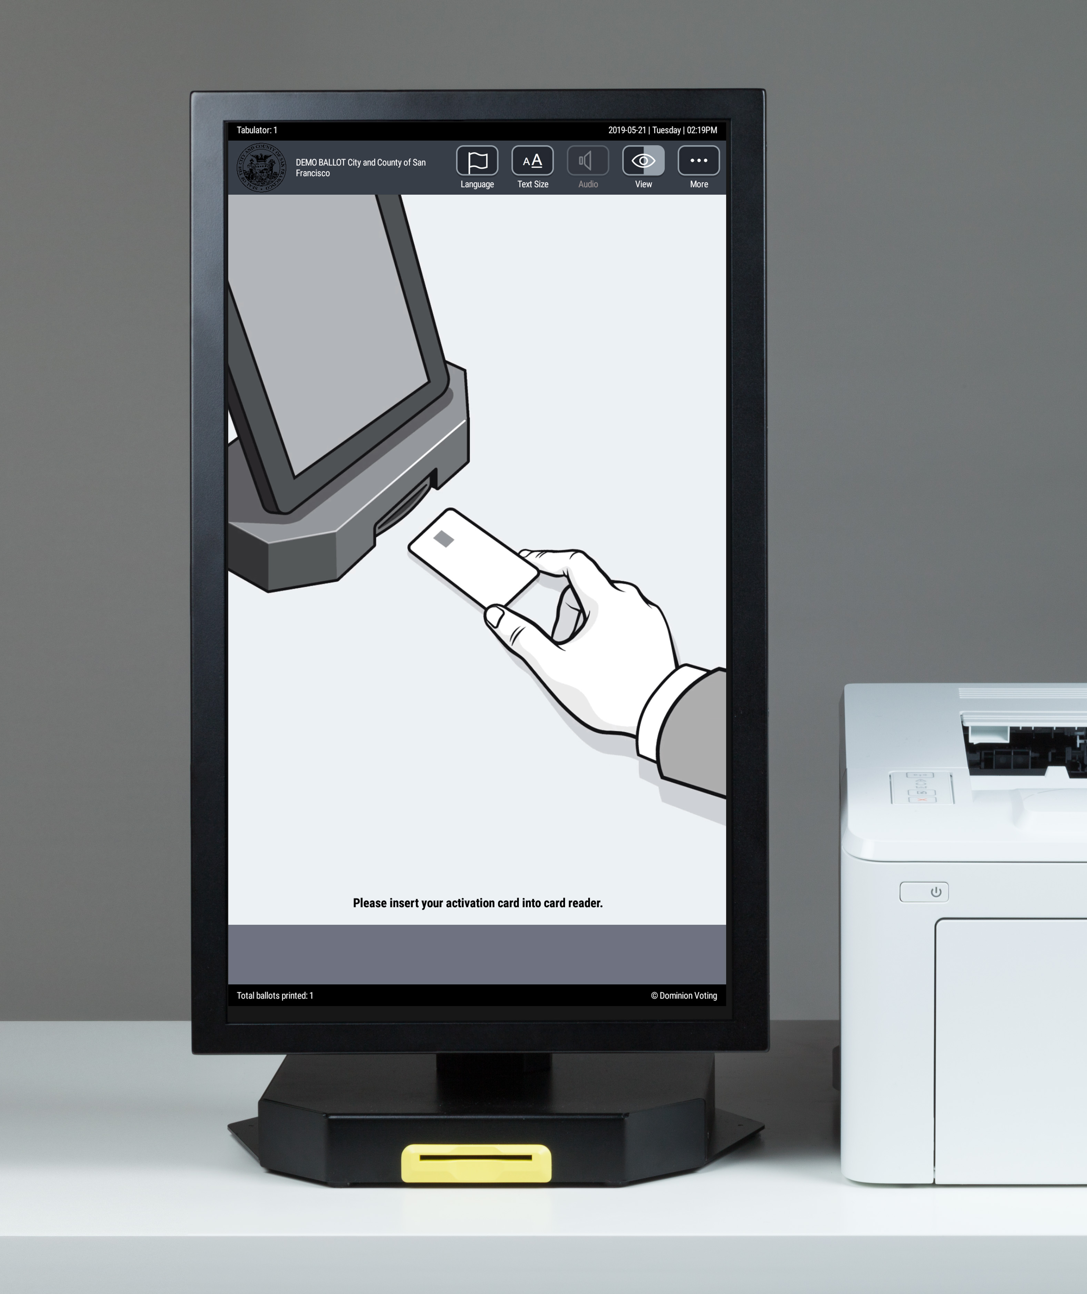
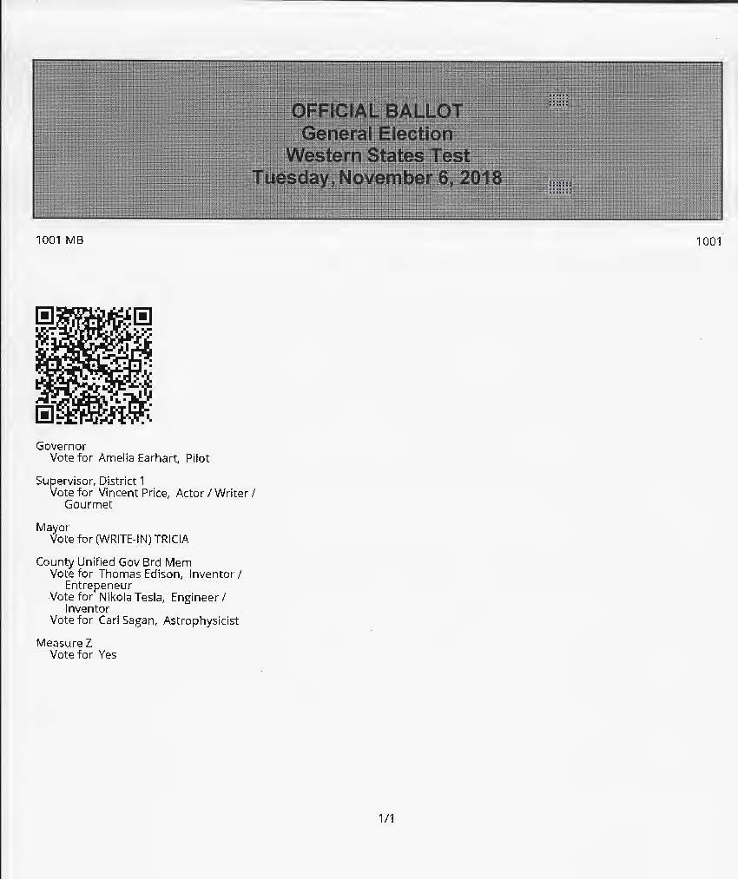
Paper ballots marked with the tablet
An elections worker will insert a card to key up your ballot.
The next screen, you select your language.
Then you make your selections.
When you are done, your ballot will be printed. Your selections are printed on the ballot for you to review.

Slide 26
10 Voter Service Center locations used in March – only 4 work for November
Santa Cruz County Clerk/Elections Office
Watsonville City Clerk’s Office
Simpkins Family Swim Center
Capitola City Hall – too small
Community Foundation - too small
Pajaro Valley Community Conference Room – space is sufficient
UCSC – Bay Tree Conference Center – we will be on campus somewhere, but not a huge center due to students not being on campus
Scotts Valley Skypark – too small
Zayante Fire Station – concerned about public being in an emergency facility
Ag Extension/Behavioral Health – too small

Slide 27
Possible locations for November – we need 17
Kaiser Arena
Temple Beth El
Scotts Valley Community Center
Soquel Conference Center
La Selva Beach Clubhouse
New Brighton Middle School
Capitola Mall
Scotts Valley High School or Middle School
Westlake Elementary or Peace United Church
San Lorenzo Valley High School
Highlands Park
Felton Community Hall or Library
Brookdale Lodge
CT English – Summit
Bonny Doon Elementary
Something in Davenport?
Boulder Creek?

Slide 28
Parking lot/mobile voting
Masks will be required!

Slide 29
Recruiting election workers
300 people to staff the voting locations
28 to clear ballot drop boxes
50 to staff voter hotline
50 for Election Night returns
Apply online at www.votescount.us
This Photo by Unknown Author is licensed under CC BY-SA-NC
This Photo by Unknown Author is licensed under CC BY-SA-NC

Slide 30
We need to flatten the voting curve!

Slide 31
Turnout during the last 4 days at our Voter Service Centers

Slide 32
March numbers
Registered voters: 163,526
Total votes cast: 103,900
Votes cast at the polls: 33,222
Votes cast by mail ballot: 70,678
Turnout = 63.56%... Or what I call a D grade!
Number of mail ballot requests: 121,579
Number of mail ballots challenged: 852
Too late: 632
No signature: 108 (77 were cured)
Sig didn’t compare: 95 (35 were cured)
Empty envelope: 14
Two ballots in one envelope: 1
Number of Same Day Registration voters: 3,086
Number counted: 2,935
Number of Provisional ballots cast: 2,802
Number counted: 2,774

Slide 33
Election Night Polls close at 8pm Ballot drop boxes close at 8pm
We will continue to prepare ballots for the count until 11pm.
At 11pm, we will focus on scanning and final counting of the ballots we have in the system.
Semi-official election night results will be released sometime after midnight.
History has shown that we will count more ballots after Election Day than on Election Night.
So no victory parties yet! Results are NOT final until all votes are counted, audited, and verified.
Election officials are big fans of big margins!!

Slide 34
The Canvass Like fine wine, it takes time.
The Canvass is the official tally of votes for any given election. The purpose of the canvass is to account for every ballot cast and ensure that every valid vote cast is counted accurately in the final election totals.
The Canvass accounts for every ballot cast on Election Day, every qualified returned ballot from voters who voted using the ballot we mail them, every qualified Same Day Voter Registration ballot, every accepted provisional ballot, every challenged ballot, and every qualified military and overseas ballot.
The Canvass enables an election official to resolve discrepancies, correct errors, and take any remedial actions necessary to ensure completeness and accuracy before certifying the election.
Estimated number of outstanding ballots will be prepared by Friday, including the number of Same Day and Provisional Ballots. We will not have the number by district until the ballots are all keyed in as returned.
There are several audits conducted during the Canvass to verify the results including a 1% manual tally of the results making sure every contest is audited.

Slide 35
Ballot processing and counting…
Since all voters will be mailed a ballot, we will process ballots and prepare for ballots to be counted as soon as they are received pursuant to a new law enacted on 6/18/2020.
Of course, we can only process votes if we have them. We encourage voters to vote early, and not wait until the last day.
Step 1 – peel signature tab from envelope (we did 70,678 ballots in March 2020!)
Step 2 – run ballots through sorter where the signature is captured.
Step 3 – clerks at computers will pull up batches where they can view 5 signatures from ballot envelopes and the signature from the corresponding voter for each voter.
Step 4 – ballots are sorted into good sigs match, no sig (letter sent) and sig compare questions, which get checked by another clerk.
Step 4a – letters are sent to the voters who did not sign their envelopes so they can fill out a form and cure their missing signature.
Step 4b – envelopes where sigs don’t compare are put through two clerks for double checking. We will try to search for other signatures, printing, etc. We will try to call or email the voter if they have provided that information. Otherwise, they are sent a letter with a form they can fill out to cure their non-comparing signature.

Slide 36
…Ballot processing and counting
Step 5- envelopes are opened and ballots are extracted.
Step 5a – clerks work in teams and make sure if they have 100 empty envelopes, they have 100 ballots.
Step 5b – if there are any ballots that cannot be read by the scanners due to tears or spills, the ballots are sent to a ballot duplicating board.
Two-person duplicating boards remake any problem ballots. Original ballots are maintained as the official voting record.
Step 6 – ballots are bundled and labeled with a form to be sent to ballot counting.
Step 7 – ballots are counted in batches and the form is completed with the operator number, initials, number counted, and number rejected.
Step 7a – ballots that have been successfully counted are put into boxes, marked and stored.
Step 7b – ballots that were not counted, go to a ballot duplicating board.
Step 8 – ballots that need adjudication, are reconciled at computer stations.
Step 9 – ballots are tallied, and the vote is audited.
Step 10 – the ballot count is posted on the website as an update.

Slide 37
Final Election Results
Deadline to certify is December1 for presidential contest, December3 for all others.
By November 30, the county elections official shall declare the elected candidate or candidates to all school and special district holding elections in November. This statutory deadline conflicts with the first one.
Within five (5) days after the completion of the official canvass, any voter may request a recount by filing a written request with the Elections official and specifying that candidates and/or measures are to be recounted.

Slide 38
Assuming office
December 4 – Special Districts: Candidates declared elected or appointed take office this date at noon after having taken the oath or posted any bond required by the principal act. §10554
December 4 – School and Community College Districts: Candidates elected to school board take office, though no reference is made to “noon.”
December 7 – State Senate and State Assembly Members take office.
December 8 – Santa Cruz & Watsonville City council members take office.
December 10 – Capitola City council members take office.
December 16 – Scotts Valley City council members take office.
January 3 – Congressional members take office.
January 4 – County Supervisors and Superior Court Judges take office.
January 20 – Inauguration Day. President takes office at noon.

Slide 39
Outstanding issues
Hotline for voter questions and election worker questions
App to track wait times at voting locations. How to manage lines.
New laws: SB 423 (Umberg) and AB 860 (Berman)
What will be happening with the virus in October/November. Need flexibility.
Staffing and training of election workers
Establish mechanism for public feedback and suggestions
One place to get latest election news – VOTESCOUNT.US
Funding – How do we pay for this?

Slide 40
Voter outreach efforts
Assisted living facilities
Hospitals
Jails and inmate facilities
UCSC – voters who are here and studying remotely & Cabrillo
High School voter education
Voters with disabilities
Language accessibility

Slide 41
Postcard going out to all voters in Mid August

Slide 42
Some social media graphics

Slide 43
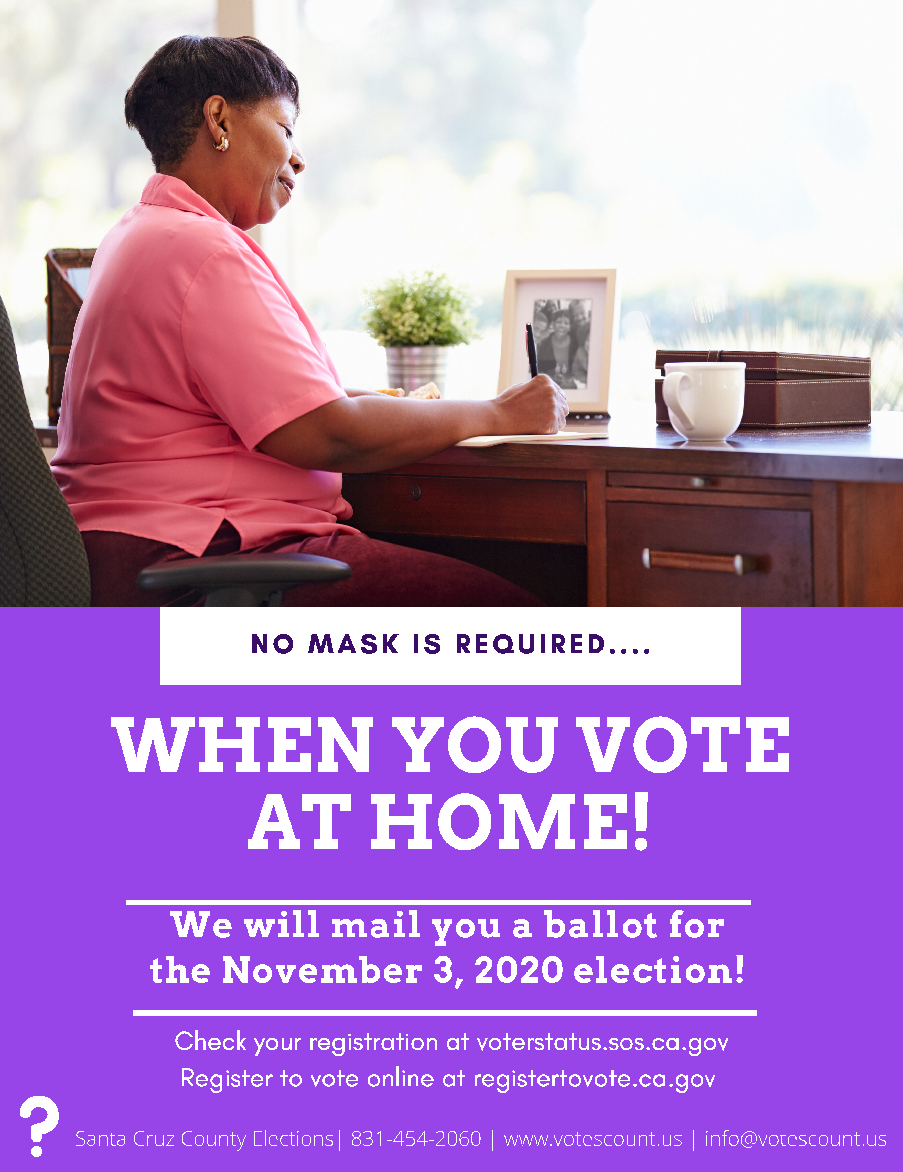
Flyer in English and Spanish

Slide 44
How we PLAN to Promote the Vote!
Social Media
Trusted messengers
Precinct captains
YouTube Videos
Voting Matters Zoom events
Honor veterans. Vote.
Democracy at work
Other ideas?

Slide 45
What you can do to promote the vote
Chalk Art
Rock Art
Messages on your car
Social Media
Encourage friends and family
Talk to EVERYONE… EVERYWHERE

Slide 46
Help spread the three easy steps.
Sign up
Sign up to vote or update your info at RegisterToVote.ca.gov
Check up
Check your info at VoterStatus.sos.ca.gov
Track it
Sign up to track your ballot at WheresMyBallot.sos.ca.gov

Slide 47
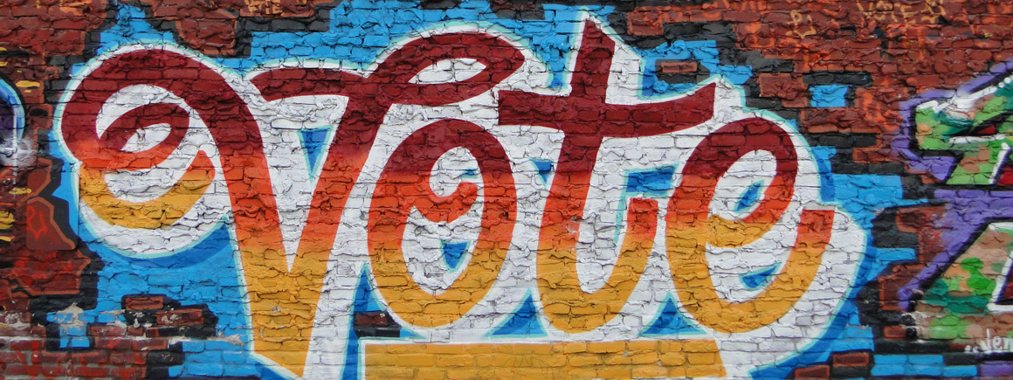
Most important message!!!

Slide 48
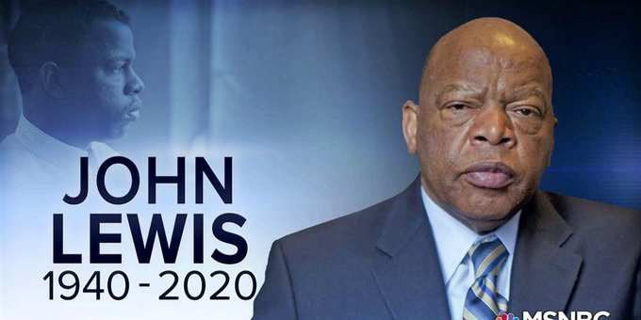
Questions? Feedback? Next “Voting Matters”?
"Democracy is not a state. It is an act, and each generation must do its part ....“ - John Lewis
Gail.Pellerin@santacruzcounty.us
831-454-2419
www.votescount.us

